Slide 1

Introduction to Machine Learning
Natural Language Processing
By <Trainer’s Name>
<Date>

Slide 2
Natural Language Processing
<Topic>

Slide 3

Natural Language Processing
What is NLP?
Study of interaction between computers and human languages NLP = Computer Science + AI + Computational Linguistics

Slide 4



Common NLP Tasks
Hard
Easy Medium
Chunking
Part-of-Speech Tagging
Named Entity Recognition
Spam Detection
Thesaurus
Syntactic Parsing
Word Sense Disambiguation
Sentiment Analysis
Topic Modeling
Information Retrieval
Machine Translation
Text Generation
Automatic Summarization
Question Answering
Conversational Interfaces

Slide 5
Basic Concepts in NLP
NLP to Text Mining
Lexical analysis (Part-of Speech Tagging)
This is the best thing happened in my
life.
Det.
Verb Det. Adj N
Verb
Pre.
PN N
Noun Phrase
Noun Phrase
Prep Phrase
Syntactic analysis (Parsing)
Prep Phrase
Sentence

Slide 6
Parsing
NLP to Text Mining
Output of the encoder should be equivalent to the input
Parsing is the process of determining whether a string of tokens can be generated by a grammar
parse tree
token
Input
Lexical Analyzer
Rest of Front End
Parser
Intermediate representation
getNext
Token
Symbol table

Slide 7
Parsing Example (for Compiler)
NLP to Text Mining
Grammar:
E :: = E op E | - E | (E) | id
op :: = + | - | * | /
a * - ( b + c )
E
id
op
E
-
E
(
E
)
id op
id

Slide 8
Basic Concepts in NLP
NLP to Text Mining
Lexical analysis (Part-of Speech Tagging)
This is the best thing happened in my
life.
Det.
Verb Det. Adj N
Verb
Pre.
PN N
Noun Phrase
Noun Phrase
Prep Phrase
Syntactic analysis (Parsing)
Prep Phrase
Sentence
This? (t1) Best thing (t2) My (m1)
Happened (t1, t2, m1)
Semantic Analysis
Inference
Happy (x) if Happened (t1, ‘Best’, m1)
Happy

Slide 9
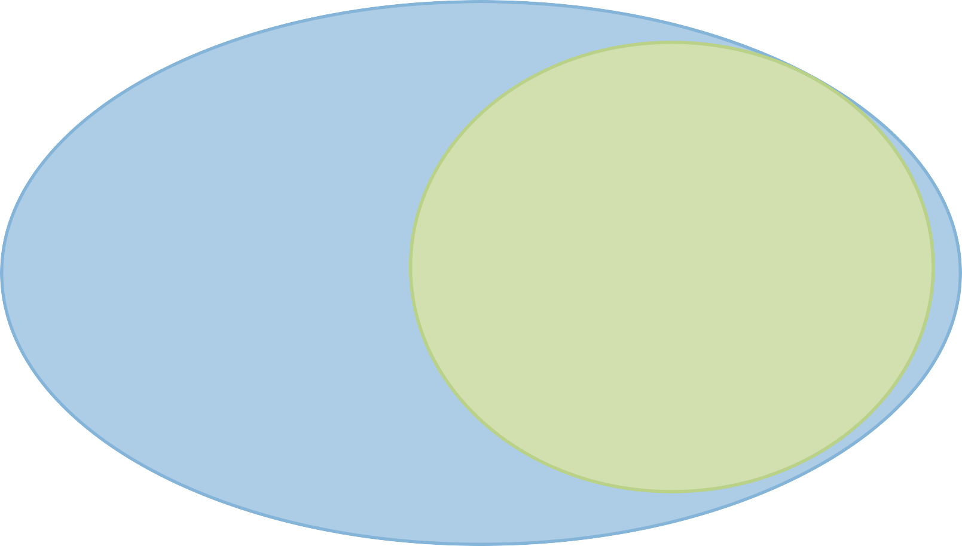
NLP to Natural Language Understanding (NLU)
NLP to Text Mining
NLP
Part-Of-Speech
Automatic Speech Recognition (ASR)
NLU
Tagging (POS)
Syntactic Parsing
Named Entity Recognition (NER)
Relation Extraction
Semantic Parsing
Paraphrase & Natural Language Inference
Question Answering (QA)
Text Categorization
Sentiment Analysis
Co-Reference
Resolution
Machine
Translation
Dialogue Agents
Summarization
Text-To-Speech (TTS)

Slide 10
NLP Techniques
NLP Techniques
Word segmentation
Part of speech tagging (POS)
Stemming
Syntactic Parsing
Named entity extraction
Co-reference resolution
Text categorization

Slide 11
Stemming
Stemming
Reduce terms to their “roots” before indexing
“Stemming” suggest crude affix chopping
language dependent
e.g., automate(s), automatic, automation all reduced to automat.
for exampl compress and
compress ar both accept
as equival to compress
for example compressed
and compression are both
accepted as equivalent to
compress.

Slide 12
Lemmatization
Lemmatization
Reduce inflectional/variant forms to base form
E.g.,
am, are, is → be
car, cars, car's, cars' → car
the boy's cars are different colors → the boy car be different color
Lemmatization implies doing “proper” reduction to dictionary headword form

Slide 13
NLP Techniques
NLP Techniques
Word segmentation
Part of speech tagging (POS)
Stemming
Syntactic Parsing
Named entity extraction
Co-reference resolution
Text categorization
Obtain representations

Slide 14
Vector Space Model (Bag of Words)
Vector Space Model (Bag of Words)
Represent the keywords of objects using a term vector
Term: basic concept, e.g., keywords to describe an object
Each term represents one dimension in a vector
Values of each term in a vector corresponds to the importance of that term
Words are used as features without the order
Usually working with N-gram features

Slide 15
Term Frequency and Inverse Document Frequency (TFIDF)
Since not all objects in the vector space are equally important, we can weight each term using its occurrence probability in the object description
Term frequency: TF(d,t)
→ number of times t occurs in the object description d
Inverse document frequency: IDF(t)
→ to scale down the terms that occur in many descriptions

Slide 16
BOW Vectors
BOW Vectors
 | team | coach | pla y | ball | score | game | wi n | lost | timeout | season
Document 1 | 3 | 0 | 5 | 0 | 2 | 6 | 0 | 2 | 0 | 2
Document 2 | 0 | 7 | 0 | 2 | 1 | 0 | 0 | 3 | 0 | 0
Document 3 | 0 | 1 | 0 | 0 | 1 | 2 | 2 | 0 | 3 | 0
TFIDF+BOW still close to the state of the art
Good baseline to start with

Slide 17
Limitation of Bag of Words
Limitation of Bag of Words
No semantical relationship between words
Not designed to model linguistic knowledge
Sparsity
Due to high number of dimensions
Curse of dimensionality
When dimensionality increases, the distance between points becomes less meaningful

Slide 18
Word Context
Word Context
A medical
Some medical
Medical
doctor is a person who uses medicine to treat illness and injuries doctors only work on certain diseases or injuries
doctors examine, diagnose and treat patients
These words represents doctors/doctor
Intuition: the context represents the semantics
Hypothesis: more simple models trained on more data will result in better word representations

Slide 19
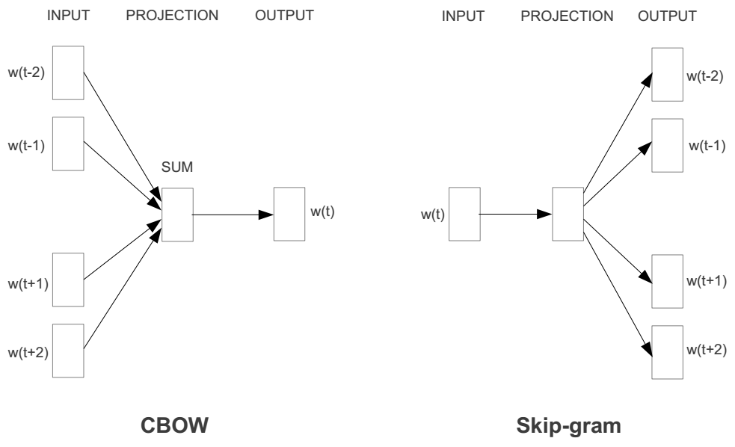
Main Ideas of Word2Vec
Main Ideas of Word2Vec
Two models:
Continuous bag-of-words model
Continuous skip-gram model
Utilize a neural network to learn the weights of the word vectors

Slide 20
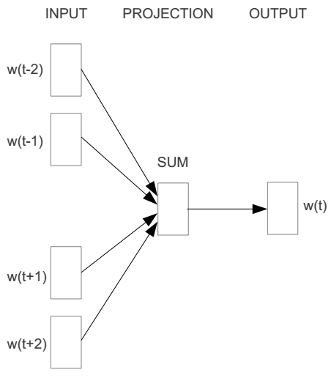
Word2vec – Continuous Bag of Word
Word2vec – Continuous Bag of Word
E.g. “The cat sat on floor”
Window size = 2
the
cat
sat
on
floor

Slide 21
Word2vec – Continuous Bag of Word
Word2vec – Continuous Bag of Word
Input layer
Index of cat in vocabulary
0
1
0
cat
0
Hidden layer
Output layer
0
0
0
0
0
0
…
0
one-hot
vector
0
0
one-hot
vector
0
sat
0
0
0
0
1
0
…
1
0
on
0
0
0
0
…
0

Slide 22



Word2vec – Continuous Bag of Word
We must learn W and W’
Input layer
0
1
0
cat
0
$$W_{V×N}$$
Hidden layer
Output layer
0
0
0
0
0
0
V-dim
…
0
0
$${W′}_{N×V}$$
0
0
sat
0
0
0
0
1
0
$$W_{V×N}$$
N-dim
…
V-dim
1
0
on
0
0
0
0
V-dim
…
N will be the size of word vector
0

Slide 23
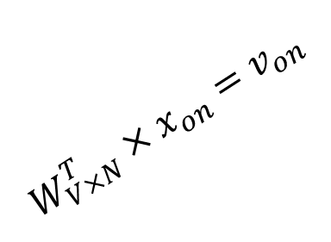

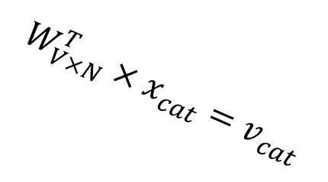



Word2vec – Continuous Bag of Word
$$W_{V×N}^{T} ×x_{cat}=v_{cat}$$
Input layer
0.1 | 2.4 | 1.6 | 1.8 | 0.5 | 0.9 | … | … | … | 3.2
0.5 | 2.6 | 1.4 | 2.9 | 1.5 | 3.6 | … | … | … | 6.1
… | … | … | … | … | … | … | … | … | …
… | … | … | … | … | … | … | … | … | …
0.6 | 1.8 | 2.7 | 1.9 | 2.4 | 2.0 | … | … | … | 1.2
0
2.4
2.6
…
…
1.8
1
0
$$×$$
0
$$=$$
1
0
0
0
0
0
x_{cat}
0
0
Output layer
0
0
0
$$W_{V×N}^{T}×x_{cat}=v_{cat}$$
…
0
0
0
0
V-dim
…
0
0
$$\hat{v}=\frac{v_{cat}+v_{on}}{2}$$
0
+
0
sat
0
0
0
0
$$W_{V×N}^{T}×x_{on}=v_{on}$$
1
0
…
V-dim
1
Hidden layer
0
x_{on}
0
0
N-dim
0
0
V-dim
…
0

Slide 24

Word2vec – Continuous Bag of Word
$$W_{V×N}^{T} ×x_{on}=v_{on}$$
Input layer
0.1 | 2.4 | 1.6 | 1.8 | 0.5 | 0.9 | … | … | … | 3.2
0.5 | 2.6 | 1.4 | 2.9 | 1.5 | 3.6 | … | … | … | 6.1
… | … | … | … | … | … | … | … | … | …
… | … | … | … | … | … | … | … | … | …
0.6 | 1.8 | 2.7 | 1.9 | 2.4 | 2.0 | … | … | … | 1.2
0
1.8
2.9
…
…
1.9
0
0
$$×$$
0
$$=$$
1
1
0
0
0
0
x_{cat}
0
0
Output layer
0
0
0
$$W_{V×N}^{T}×x_{cat}=v_{cat}$$
…
0
0
0
0
V-dim
…
0
0
$$\hat{v}=\frac{v_{cat}+v_{on}}{2}$$
0
+
0
sat
0
0
0
0
$$W_{V×N}^{T}×x_{on}=v_{on}$$
1
0
…
V-dim
1
Hidden layer
0
x_{on}
0
0
N-dim
0
0
V-dim
…
0

Slide 25






Word2vec – Continuous Bag of Word
Input layer
0
1
0
cat
0
$$W_{V×N}$$
Hidden layer
Output layer
0
0
0
0
0
0
V-dim
…
0
0
$$W_{V×N}^{′}×\hat{v}=z$$
0
$$\hat{y}=softmax(z)$$
0
0
0
0
0
$$\hat{v}$$
1
0
$$W_{V×N}$$
…
1
N-dim
0
on
0
${\hat{y}}_{sat}$
0
0
V-dim
0
V-dim
…
N will be the size of word vector
0

Slide 26




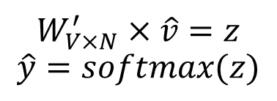
Word2vec – Continuous Bag of Word
Input layer
0
We would prefer $\hat{y}$ close to ${\hat{y}}_{sat}$
1
0
cat
0
$$W_{V×N}$$
Hidden layer
Output layer
0
0
0.01
0.02
0.00
0.02
0.01
0.02
0.01
0.7
…
0.00
0
0
0
0
V-dim
…
0
0
$$W_{V×N}^{′}×\hat{v}=z$$
$$\hat{y}=softmax(z)$$
0
0
0
0
0
0
$$\hat{v}$$
1
0
$$W_{V×N}$$
…
1
N-dim
0
on
0
${\hat{y}}_{sat}$
0
0
V-dim
0
V-dim
…
N will be the size of word vector
$\hat{y}$
0

Slide 27




Word2vec – Continuous Bag of Word
$$W_{V×N}^{T}$$
Input layer
0.1 | 2.4 | 1.6 | 1.8 | 0.5 | 0.9 | … | … | … | 3.2
0.5 | 2.6 | 1.4 | 2.9 | 1.5 | 3.6 | … | … | … | 6.1
… | … | … | … | … | … | … | … | … | …
… | … | … | … | … | … | … | … | … | …
0.6 | 1.8 | 2.7 | 1.9 | 2.4 | 2.0 | … | … | … | 1.2
Contain word’s vectors
0
1
0
x_{cat}
0
Output layer
0
0
$$W_{V×N}^{}$$
0
0
0
0
V-dim
…
0
0
$$W_{V×N}^{′}$$
0
0
sat
0
0
0
0
$$W_{V×N}^{}$$
1
0
…
V-dim
1
Hidden layer
0
x_{on}
0
0
N-dim
0
0
V-dim
…
0
We can consider either W or W’ as the word’s representation. Or even take the average.
Notes:
W contains input word vectors.
W’ contains output word vectors.
We can consider either W or W’ as the word’s representation. Or even take the average.

Slide 28
Applications
Applications
Search, e.g., query expansion
Sentiment analysis
Classification
Clustering

Slide 29
Sentiment analysis
Sentiment analysis
The process of analyzing unstructured text to extract relevant information and transforming it into useful business intelligence
It determines if an expression is positive, negative, or neutral, and to what degree
It is an emerging field that attempts to analyze and measure human emotions and convert it into hard facts

Slide 30
Sentiment analysis
Sentiment analysis
Also called opinion mining since it includes identifying attitudes, emotions, and opinions of a company’s product, brand, or service
It is text analytics that looks at the face value of the words to give them meaning
Gives insight into the emotion behind the words
Helps businesses monitor news articles, online forums and social networking sites for trends in opinions about their products and services

Slide 31
Sentiment analysis
Sentiment analysis
Businesses have realized that not all opinions are equally important- Some opinions carry more weight than others
A negative tweet by Lady Gaga will have a much greater impact than a tweet by an ordinary person
It is a tool to allow users to generate ‘influence scores’ to identify people, blogs, forums etc. that are important

Slide 32









Sentiment analysis
Review Mining
Opinion Mining
Subjective Analysis
Appraisal Extraction
Synonymous & Interchangeable Names

Slide 33






Sentiment analysis: How does it work?
Collect Data
Analyze Data
Indexing
Delivery
Social Media, Blogs, Twitter, News, Product Reviews
Algorithms process the data and performs sentence splitting
Algorithms tag sentences based on polarity and intensity sentiments
Provides an output reporting the outcome of the analysis

Slide 34



Sentiment analysis: How Machines Learn ?
It is a structural process where every stage builds a better version
Data as Input
Text files, Spreadsheets, SQL Databases
Abstracting the Data
Representation of the data in a structural format through the algorithm chosen
Elementary Learning
Generalization
Practical Application
Where the learning from the previous step is used to develop an insight

Slide 35
Topic Modeling
Topic Modelling
●
Topic Modeling is a set of techniques that aim to discover and annotate large archives of documents with thematic information.
TM is a set of methods that analyze the words (or other fine-grained features) of the original documents to discover the themes that run through them, how those themes are connected to each other, and how they change over time.
Often, the number of topics to be discovered is predefined.
Topic modeling can be seen as a dimensionality reduction technique
Topic modeling, like clustering, do not require any prior annotations or labeling, but in contrast to clustering, can assign document to multiple topics.
Semantic information can be derived from a word-document co-occurrence matrix Topic Model types:
●
●
●
●
●
●
–
–
Linear algebra based (e.g. LSA)
Probabilistic modeling based (e.g. pLSA, LDA, Random Projections)

Slide 36


Thank You

